Slide 1
Cornerstone City Church Peninsula Plus Community Hoo Are Ya
17th August 2025

Slide 2


Slide 3
God Is For Us
CCLI Song # 7121853
James Ferguson | James Tealy | Jesse Reeves | Jonny Robinson | Michael Farren | Rich Thompson | Tiarne Tranter
© 2018 BEC Worship; WriterWrong Music; CityAlight Music; Farren Love And War Publishing; Integrity's Alleluia! Music; My Eleiht Songs
For use solely with the SongSelect® Terms of Use. All rights reserved. www.ccli.com
CCLI Licence No. 33265

Slide 4
1/6
We won't fear the battle
We won't fear the night
We will walk the Valley with You by our side
You will go before us
You will lead the way
We have found a refuge only You can save

Slide 5
2/6
Chorus
Sing with joy now our God is for us
The Father's love is a strong and mighty fortress
Raise your voice now no love is greater
Who can stand against us if our God is for us

Slide 6
3/6
Even when I stumble
Even when I fall
Even when I turn back still Your love is sure
You will not abandon
You will not forsake
You will cheer me onward with never ending grace

Slide 7
4/6
Chorus
Sing with joy now our God is for us
The Father's love is a strong and mighty fortress
Raise your voice now no love is greater
Who can stand against us if our God is for us

Slide 8
5/6
Neither height nor depth can separate us
Hell and death will not defeat us
He who gave His Son to free us
Holds me in His love (REPEAT)

Slide 9
6/6
Chorus
Sing with joy now our God is for us
The Father's love is a strong and mighty fortress
Raise your voice now no love is greater
Who can stand against us if our God is for us

Slide 11
Bless God
CCLI Song # 7206380
Brandon Lake | Brooke Ligertwood | Cody Carnes
© 2023 Brandon Lake Music; Brooke Ligertwood Designee; Capitol CMG Paragon; Writer's Roof Publishing
For use solely with the SongSelect® Terms of Use. All rights reserved. www.ccli.com

Slide 12
1/11
Blessed are those who run to Him
Who place their hope and confidence in Jesus
He won’t forsake them
Blessed are those who seek His face
Who bend their knee and fix their gaze on Jesus
They won’t be shaken

Slide 13
2/11
Come on and praise the Lord with me
Sing if you love His name
Come on and lift your voice with me
He’s worthy of all our praise

Slide 14
3/11
Blessed are those who walk with Him
Whose hearts are set on pilgrimage with Jesus
They’ll see His glory
Blessed are those who die to live
Whose joy it is to give it all for Jesus
And for Him only
Oh Jesus all for Your glory

Slide 15
4/11
Come on and praise the Lord with me
Sing if you love His name
Come on and lift your voice with me
He’s worthy of all our praise

Slide 16
5/11
Come on and bring your offering
Sing if you’ve known His grace
Come on and lift up your holy hands
He’s worthy of all our praise

Slide 17
6/11
Bless God in the sanctuary
Bless God in the fields of plenty
Bless God in the darkest valley
Every chance I get I bless Your name

Slide 18
7/11
Bless God when my hands are empty
Bless God with a praise that costs me
Bless God when nobody’s watching
Every chance I get I bless Your name

Slide 19
8/11
Bless God when the weapon’s forming
Bless God when the walls are falling
Bless God ‘cause He goes before me
Every chance I get I bless Your name

Slide 20
9/11
Bless God for He holds the vict’ry
Bless God for He’s always with me
Bless God for He’s always worthy
Every chance I get I bless Your name
Every chance I get I bless Your name

Slide 21
10/11
Come on and praise the Lord with me
Sing if you love His name
Come on and lift your voice with me
He’s worthy of all our praise

Slide 22
11/11
Come on and bring your offering
Sing if you’ve known His grace
Come on and lift up your holy hands
He’s worthy of all our praise He’s worthy of all our praise

Slide 23
1/4
I bless Your Name in the morning
I bless Your Name in the evening
I bless Your Name in the morning
Every chance I get I bless Your name

Slide 24
2/4
Come on and praise the Lord with me
Sing if you love His name
Come on and lift your voice with me
He’s worthy of all our praise

Slide 25
3/4
Come on and bring your offering
Sing if you’ve known His grace
Come on and lift up your holy hands
He’s worthy of all our praise He’s worthy of all our praise

Slide 26
4/4
Praise the Lord with me
Lift your voice and sing
'Cos there is no one like Him
Jesus our King

Slide 28
Make Room
CCLI Song # 7122057
Evelyn Heideriqui | Josh Farro | Lucas Cortazio | Rebekah White
© 2018 A New Song For A New Day Music; Community Music Songs; Curb Songs; Father of Lights Publishing; Mike Curb Music
For use solely with the SongSelect® Terms of Use. All rights reserved. www.ccli.com
CCLI Licence No. 33265

Slide 29
1/5
Here is where I lay it down
Every burden every crown
This is my surrender
This is my surrender
Here is where I lay it down
Every lie and every doubt
This is my surrender

Slide 30
2/5
And I will make room for you
To do whatever you want to
To do whatever you want to
And I will make room for you
To do whatever you want to
To do whatever you want to

Slide 31
3/5
Shake up the ground of all my tradition
Break down the walls of all my religion
Your way is better
Your way is better

Slide 32
4/5
And I will make room for you
To do whatever you want to
To do whatever you want to
And I will make room for you
To do whatever you want to
To do whatever you want to

Slide 33
5/5
Here is where I lay it down
You are all I'm chasing now
This is my surrender

Slide 34


Slide 35
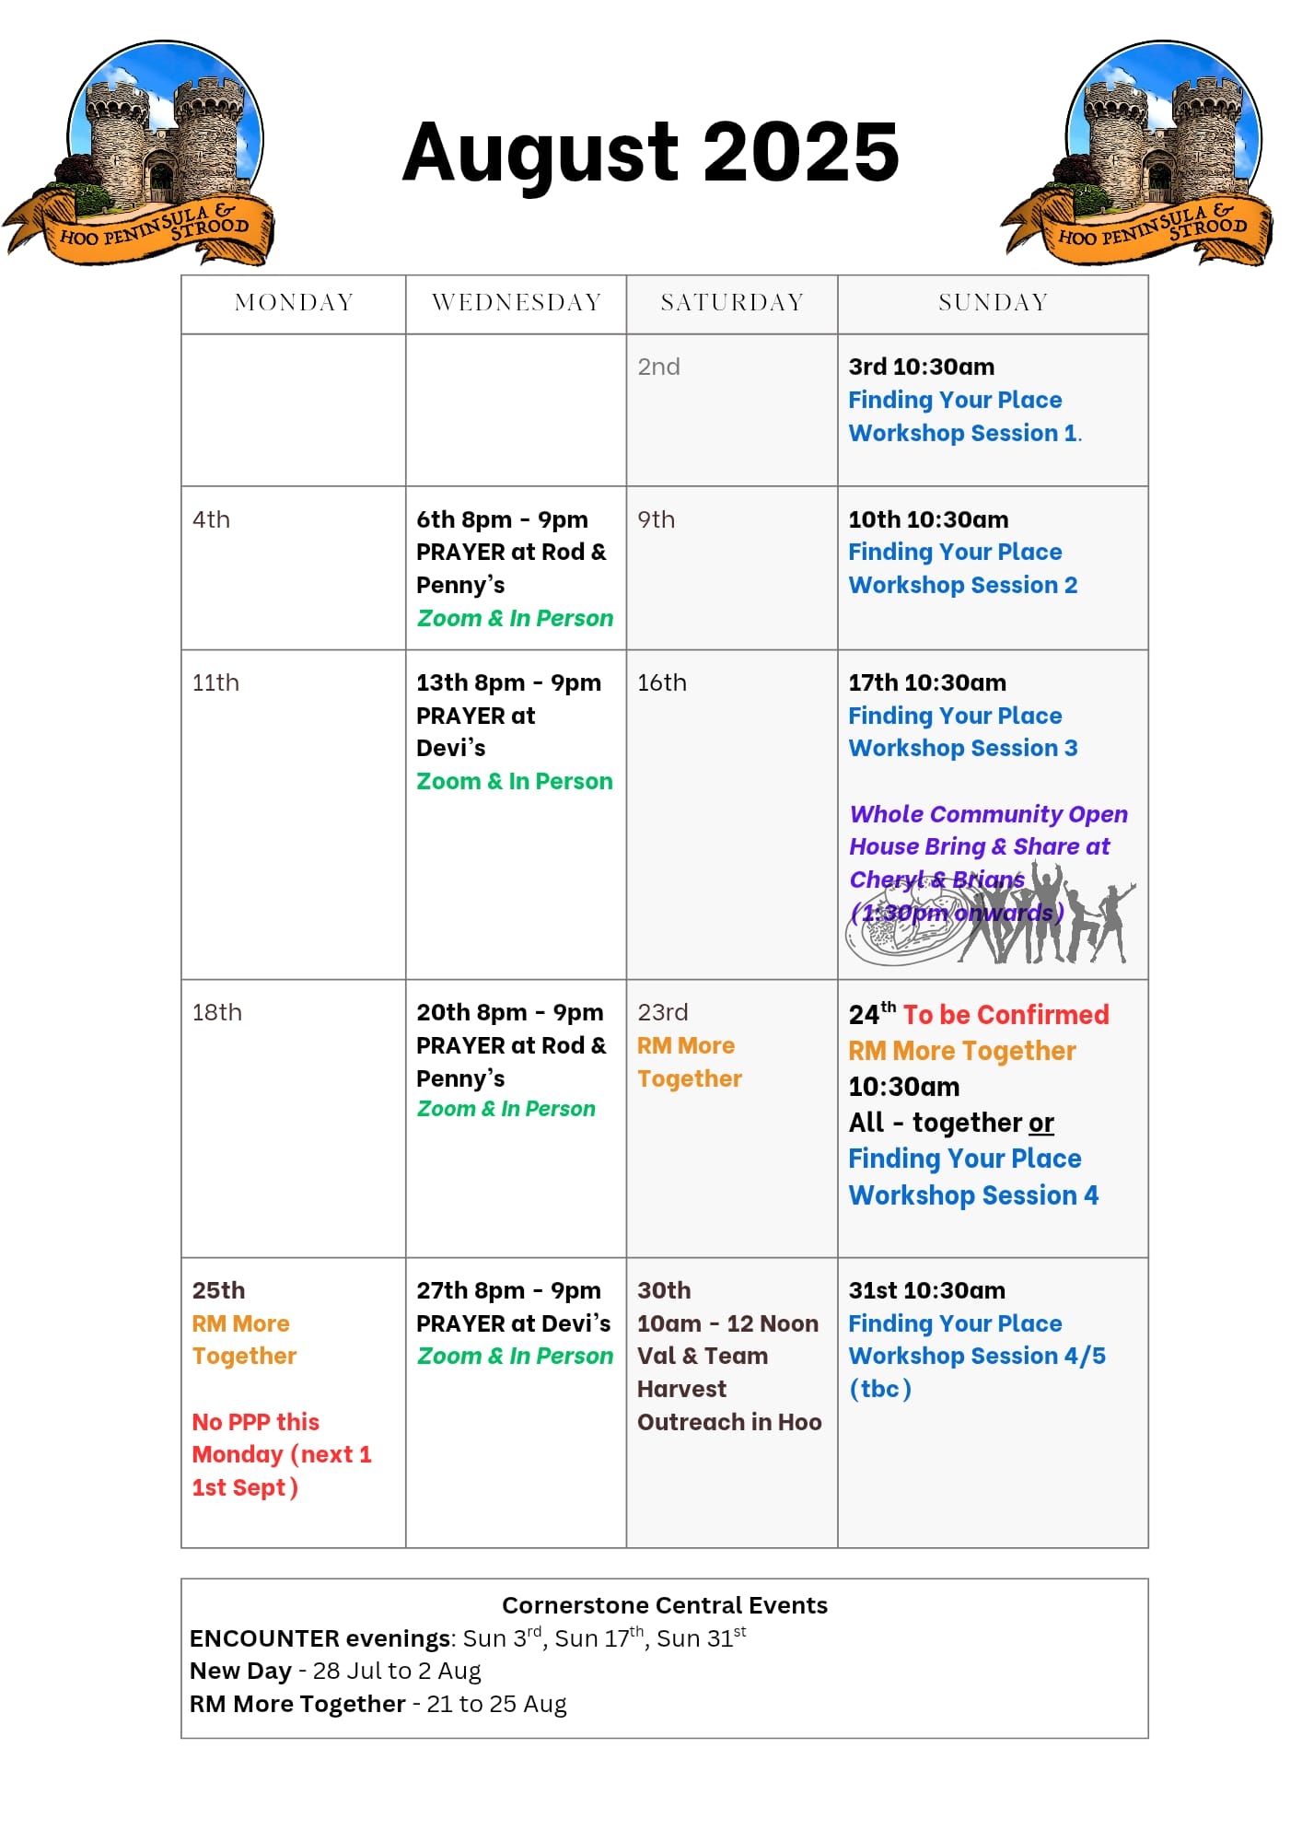

Slide 36


Slide 37

Grow Group 1
On YOUR MARK!

Slide 38
Leaders
Leaderss
Phil & Kim
Maria (Mia) Warren
Matthew Harrison
Richard & Elisha Acheampong
Phil & Kim
Maria (Mia) Warren
Matthew Harrison
Richard & Elisa Acheampong

Slide 39

Storm Walker
Storm Walker
Symbolising, trust in Jesus Christ through life's storms.
Mark 4:35-41

Slide 40


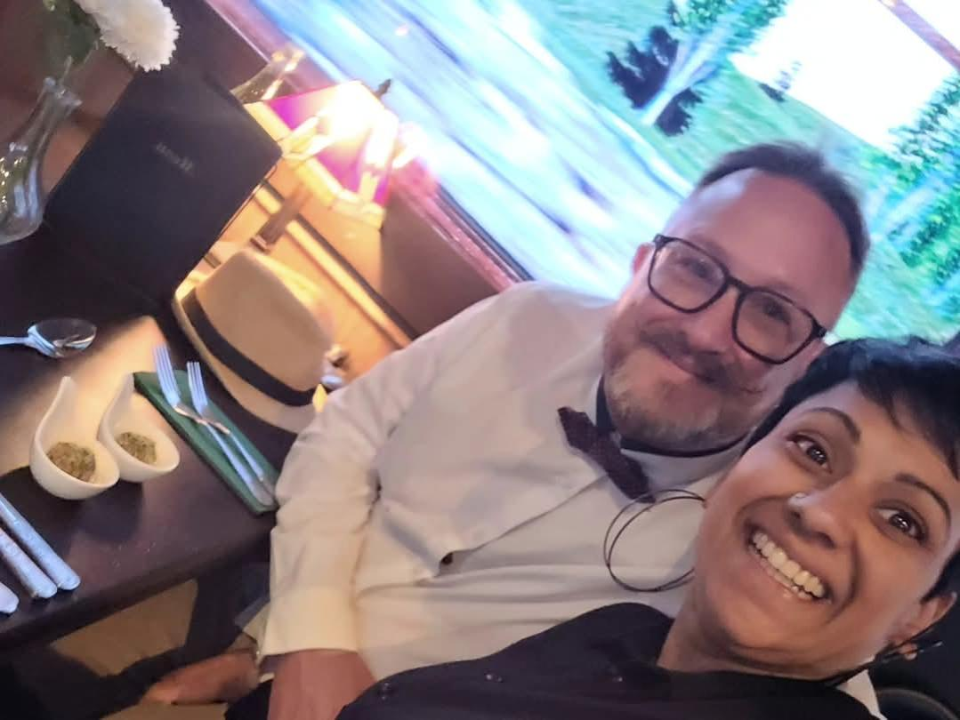
Group Leaders
Micheal and Mwamba
Wilfred and Parveen
Hannah

Slide 41


Slide 42


Slide 43


Slide 44
2 Corinthians 14 May the grace of the Lord Jesus Christ, and the love of God, and the fellowship of the Holy Spirit be with you all
Surely goodness and mercy shall follow us all the days of our lives, and we shall dwell in the house of the Lord forever.

